Slide 1

UCL CENTRE FOR ADVANCED SPATIAL ANALYSIS
THE BARTLETT
‘regional scientists and geographers have developed several models, ranging from the entropy (Wilson, 1967) to the gravity
and logit models(Anas, 1983) which has proven to be very effective in predicting different types of flows. By ignoring
for a long time this body of research, spatial economists have missed a fundamental ingredient of the space-economy.’
(Fujita and Thisse, 2013, p256)
Applied Urban Modelling Conference
Cambridge
24 – 26 June 2015
Spatial interaction under imperfect competition
Robin Morphet
r.morphet@ucl.ac.uk
‘regional scientists and geographers have developed several models, ranging from the entropy (Wilson, 1967) to the gravity and logit models(Anas, 1983) which has proven to be very effective in predicting different types of flows. By ignoring for a long time this body of research, spatial economists have missed a fundamental ingredient of the space-economy.’
(Fujita and Thisse, 2013)

Slide 2
UCL CENTRE FOR ADVANCED SPATIAL ANALYSIS
THE BARTLETT
The Problem
In a perfectly competitive economy we can expect the total value of rents (payment for the use of land at a given location) in the local economy to equal the total cost of transport. Any variation in the cost of transport will have an immediate and opposite effect on land rents. Thus it is reasonable to ignore property related issues in a transport appraisal on the assumption of perfect competition. In an imperfectly competitive world this relationship will cease to hold and there will be important changes in welfare which are not measured by the transport benefits. This is compounded by the further linkage between the labour market and property market through home ownership and potential migration. Thus a more careful
representation of the land and property markets, especially the link between property prices, home ownership, commuting and migration, is a further major requirement. This could be a further development of the labour market study recommended above.
(Transport and the Economy, SACTRA Report, 1998)

Slide 3
UCL CENTRE FOR ADVANCED SPATIAL ANALYSIS
THE BARTLETT
The Approach
Define imperfect competition and rent in spatial interaction
Examine the problem in terms of what is permitted in the spatial interaction (trip
distribution) model
Analyse a demonstration example in London
See https://www.bartlett.ucl.ac.uk/casa/publications/working-paper-199
and https://www.bartlett.ucl.ac.uk/casa/publications/working-paper-193

Slide 4
UCL CENTRE FOR ADVANCED SPATIAL ANALYSIS
THE BARTLETT
Imperfect Competition (1)
Perfect competition is achieved when transport costs are zero (Starrett 1974)
Imperfect competition arises when transport costs are non-zero although they
may be positive or negative (i.e. overcharged or subsidised)
Imperfect competition may be monopoly, oligopoly, monopolistic competition

Slide 5
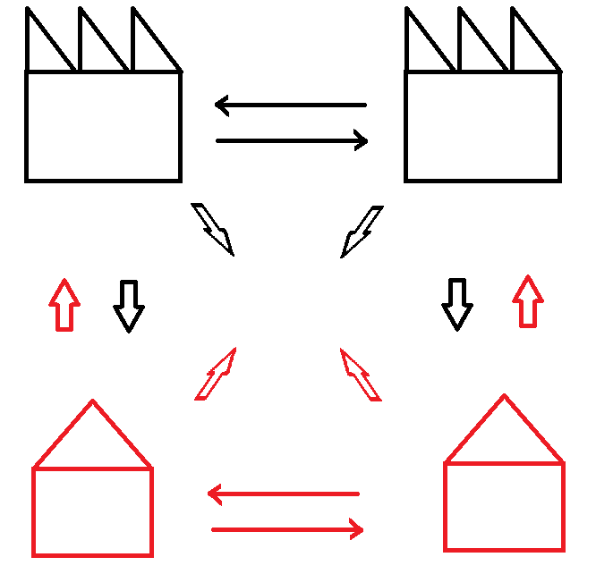
UCL CENTRE FOR ADVANCED SPATIAL ANALYSIS
THE BARTLETT
Imperfect Competition (2)
Firms compete and cooperate
Firms and households trade
Households compete and cooperate

Slide 6
UCL CENTRE FOR ADVANCED SPATIAL ANALYSIS
THE BARTLETT
Rent and Spatial Interaction
The rent in the spatial interaction model is the von Thunen land rent
per trip
It is already incorporated in the model ‘s balancing factors and is a
location rent
It can be incorporated into the generalised cost giving a generalised
trip and land cost

Slide 7
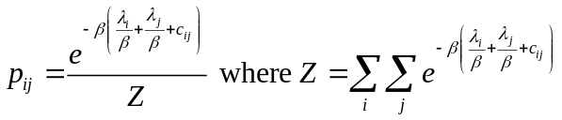


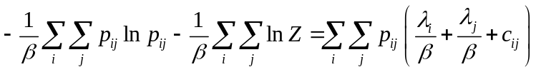
UCL CENTRE FOR ADVANCED SPATIAL ANALYSIS
THE BARTLETT
Rent, Interaction and Consumer Surplus
The standard (almost) derivation
giving
Now log both sides, multiply by divide by and sum over i,j giving
Or entropy/β - consumer surplus = expected rent + expected trip cost
Benefit equation:
Δentropy/β+<tripcost>)=Δ(Consumer surplus + <rent>)

Slide 8
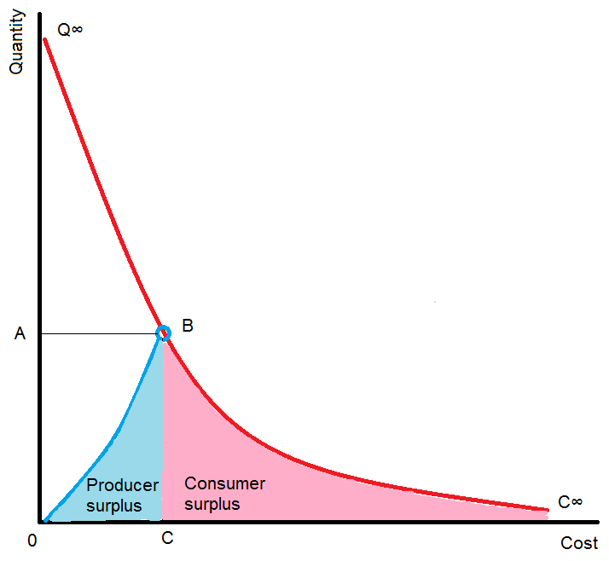
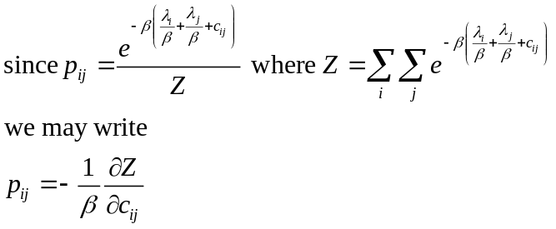
UCL CENTRE FOR ADVANCED SPATIAL ANALYSIS
THE BARTLETT
Perfect Competition in the Spatial Interaction Model
Z is the determinant of the demand curve

Slide 9
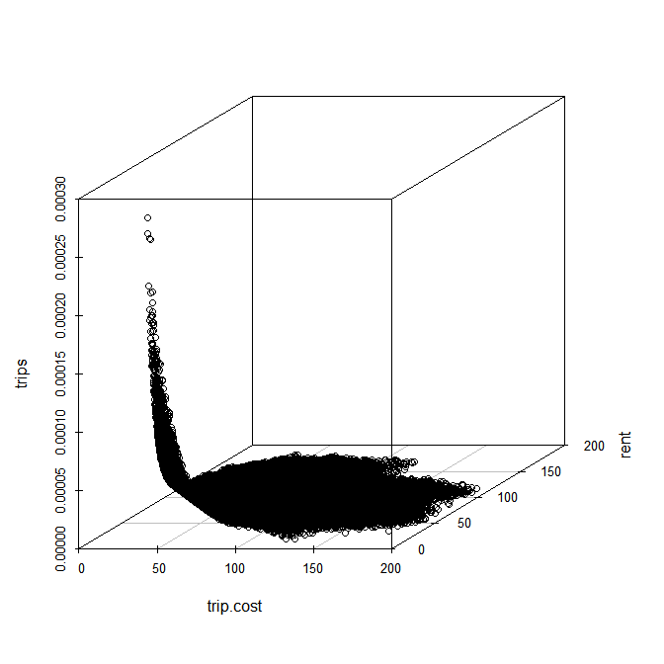
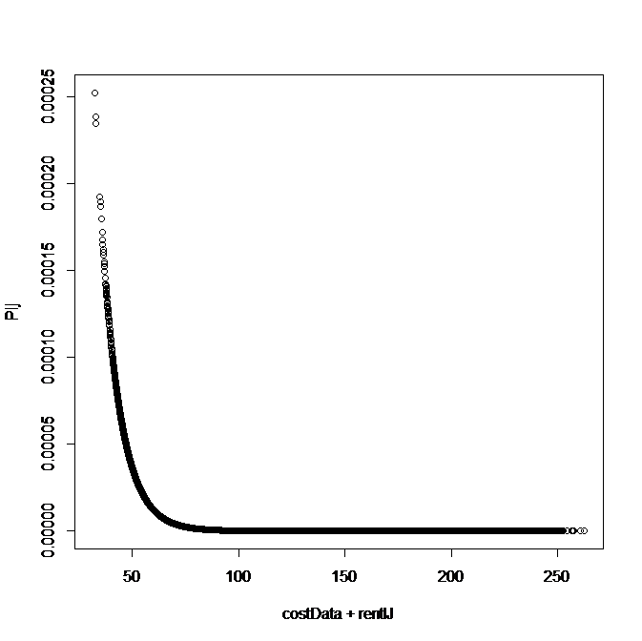
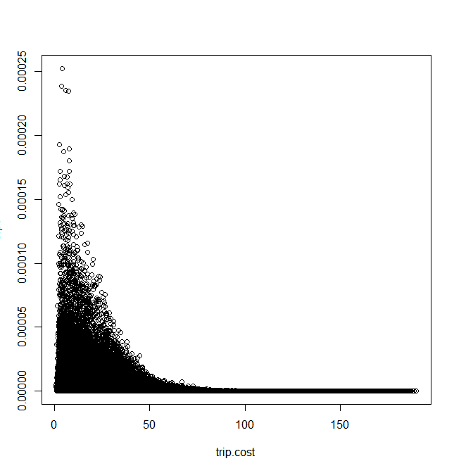
UCL CENTRE FOR ADVANCED SPATIAL ANALYSIS
THE BARTLETT
Demand Curve dependence on Rent

Slide 10
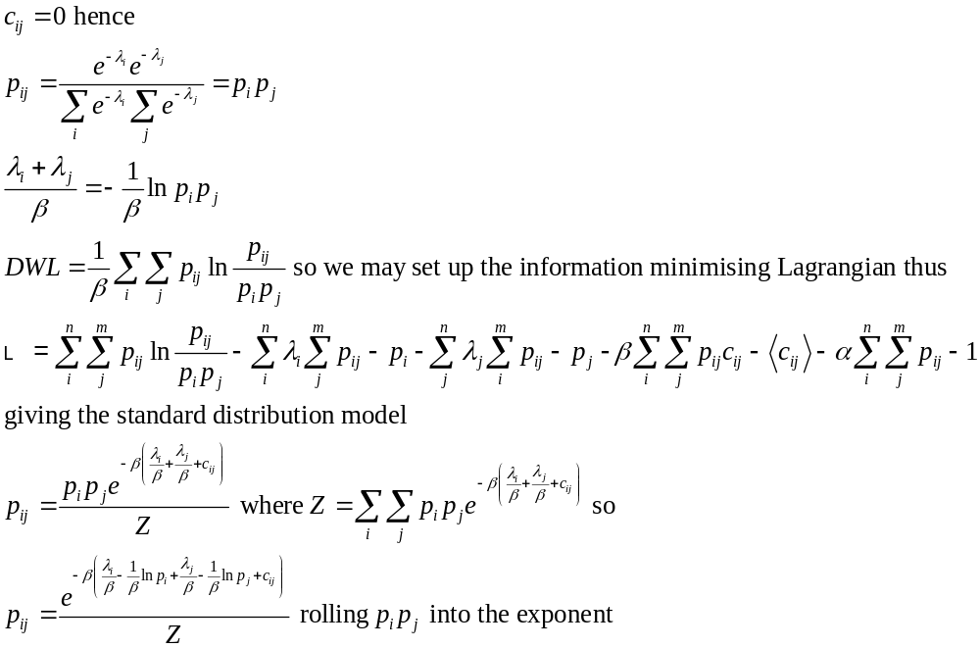
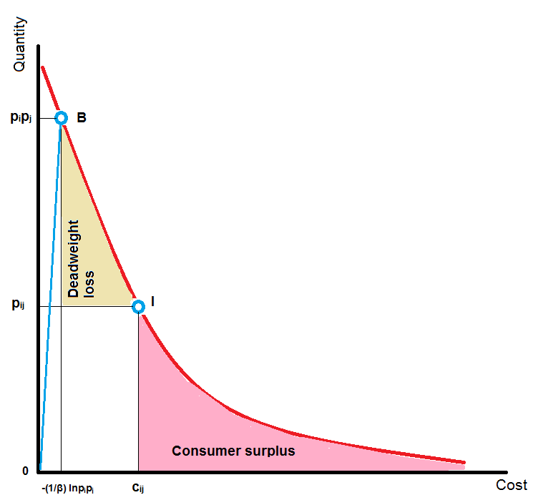
UCL CENTRE FOR ADVANCED SPATIAL ANALYSIS
THE BARTLETT
Imperfect Competition and Consumer Deadweight Loss
Benefit equation:
Δ(Deadweight loss +cost)=Δ(Consumer surplus + rent)

Slide 11
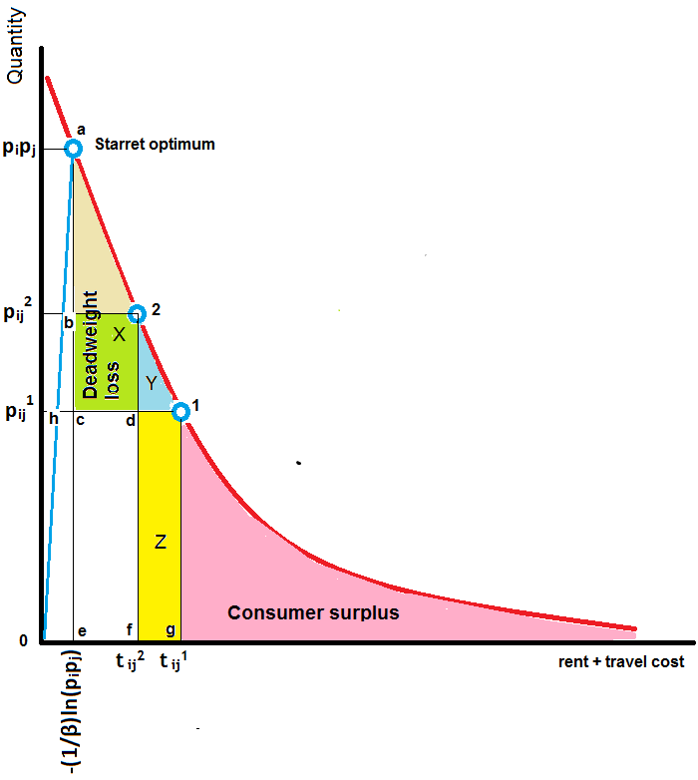
UCL CENTRE FOR ADVANCED SPATIAL ANALYSIS
THE BARTLETT
Imperfect Competition and Consumer Deadweight Loss

Slide 12
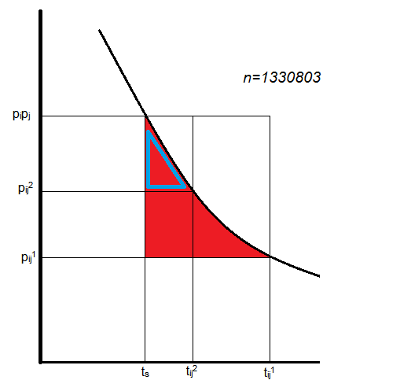
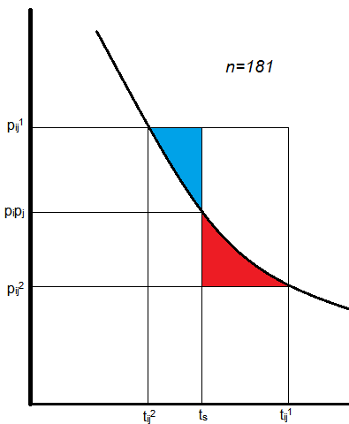
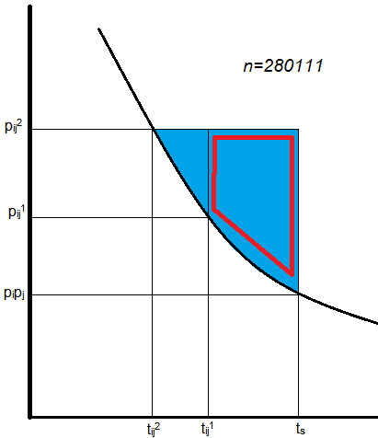
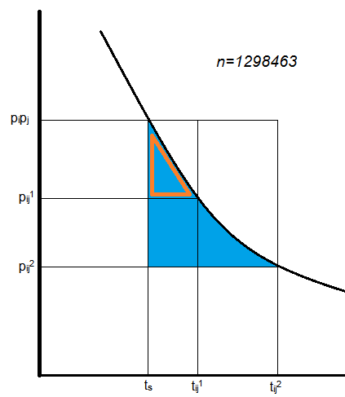
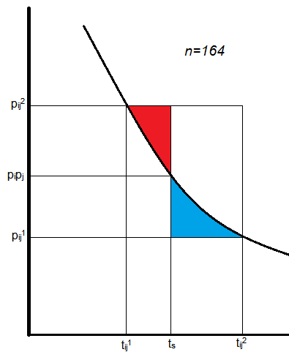
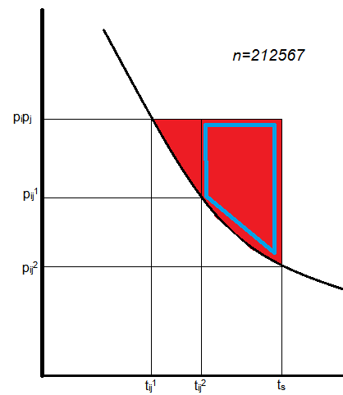
UCL CENTRE FOR ADVANCED SPATIAL ANALYSIS
THE BARTLETT
Deadweight Loss Configurations
 | {t_{ij}¹ , t_{ij}² } > t_{s} | t_{s} between {t_{ij}¹ , t_{ij}² } | {t_{ij}¹ , t_{ij}² } < t_{s}
t_{ij}¹ > t_{ij}²
t_{ij}² > t_{ij}¹

Slide 13
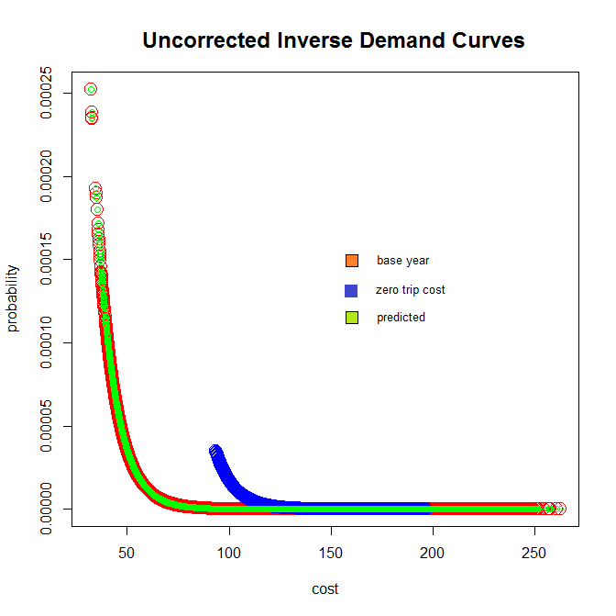
UCL CENTRE FOR ADVANCED SPATIAL ANALYSIS
THE BARTLETT
The Mandate of the Interaction Model
The interaction model is an equilibrium model
The demand curve is a series of disconnected points at equilibrium
The costs include land rent
Not all cost points are admissible
There are three distinct demand curves
We cannot move up and down the demand curve

Slide 14
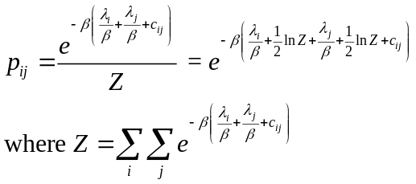

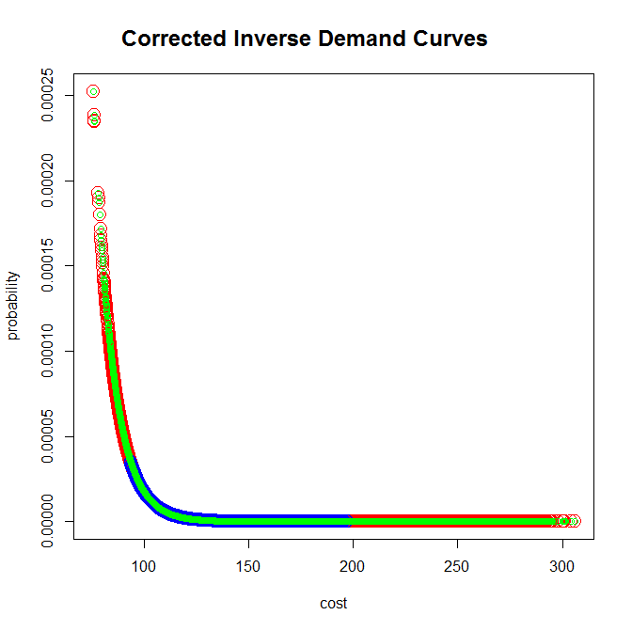
UCL CENTRE FOR ADVANCED SPATIAL ANALYSIS
THE BARTLETT
Fixing the Balancing Factors

Slide 15
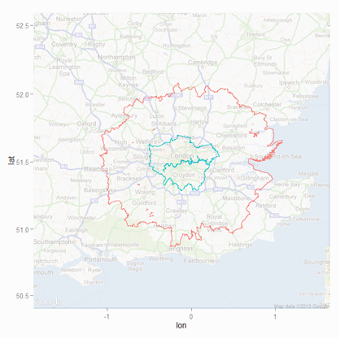
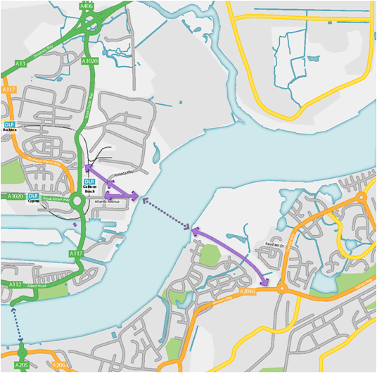
UCL CENTRE FOR ADVANCED SPATIAL ANALYSIS
THE BARTLETT
The Study Area: Gallions Reach
No. of zones: 1,767
Population: 13,428,853
Observed trips: 6,245,233

Slide 16
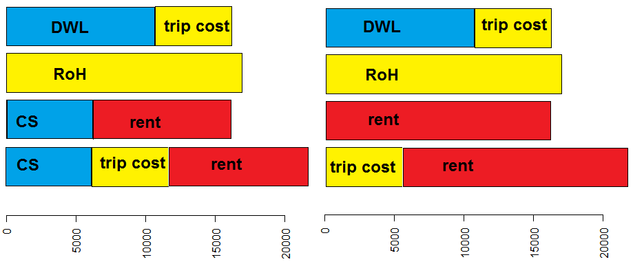
UCL CENTRE FOR ADVANCED SPATIAL ANALYSIS
THE BARTLETT
Comparison of benefit changes
Uncorrected rents
Corrected rents

Slide 17
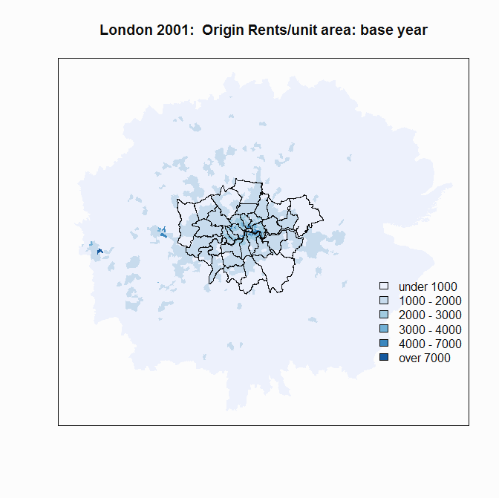
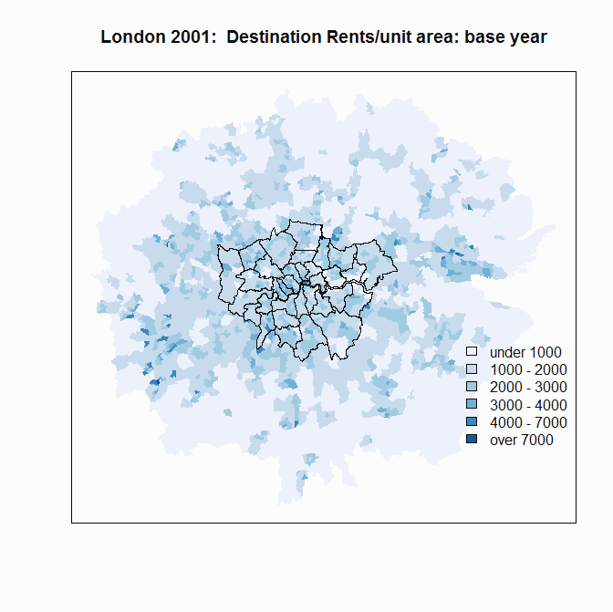
UCL CENTRE FOR ADVANCED SPATIAL ANALYSIS
THE BARTLETT
Rent Distribution

Slide 18
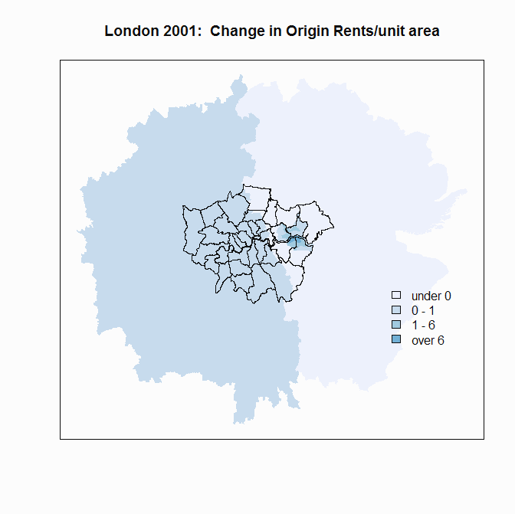
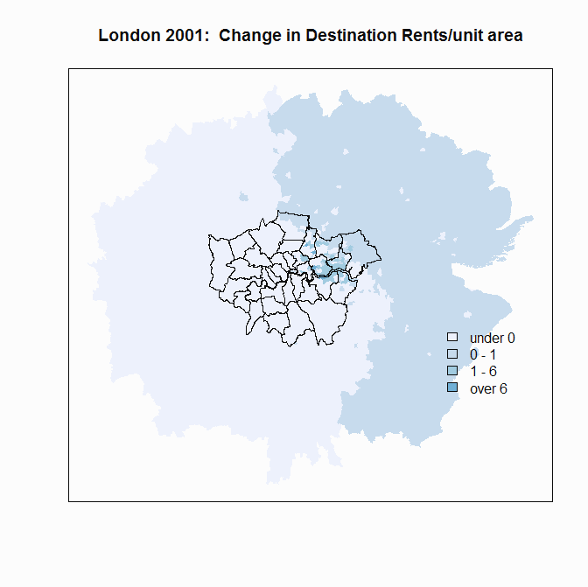
UCL CENTRE FOR ADVANCED SPATIAL ANALYSIS
THE BARTLETT
Rent Change

Slide 19
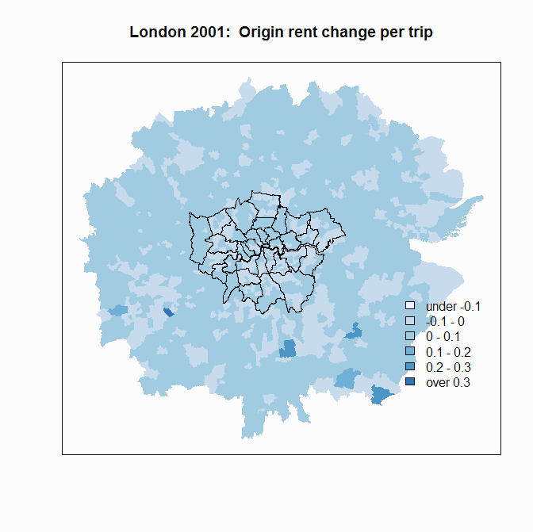
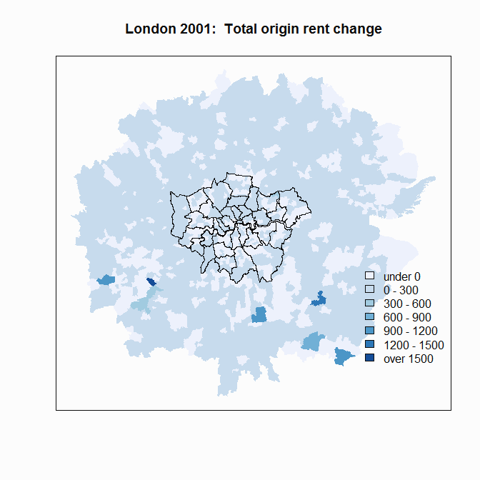
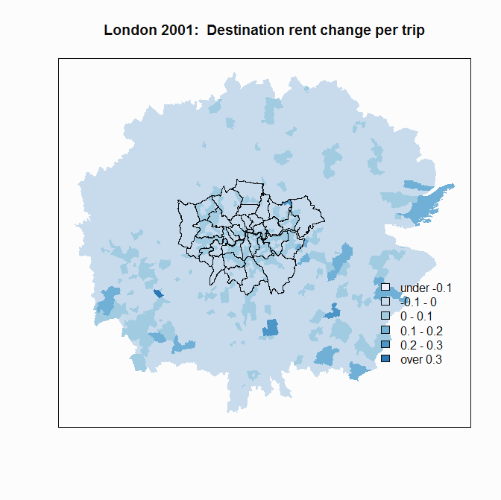
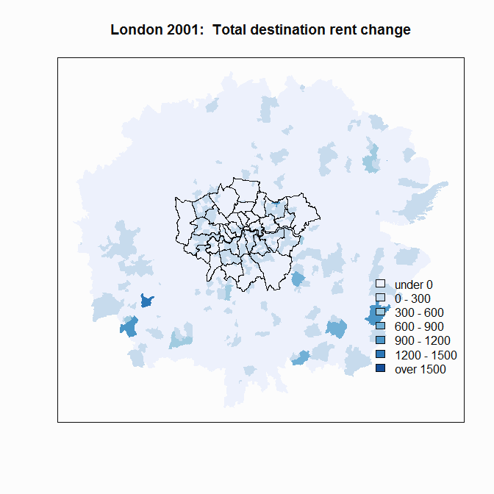
UCL CENTRE FOR ADVANCED SPATIAL ANALYSIS
THE BARTLETT
Components of Rent Change

Slide 20
UCL CENTRE FOR ADVANCED SPATIAL ANALYSIS
THE BARTLETT
Conclusions
the spatial interaction model including rent, estimates deadweight loss and
models imperfect competition
perfect competition is not feasible in a spatial economy
the benefits of transport investment can be measured by the change in
deadweight loss plus trip cost or the change in consumer surplus plus trip
cost or the maximum change in rent
the Rule of a Half approximates to these measures for small changes
the realisation of benefits is likely to require planned land use change
land rent is intrinsic to the spatial interaction model

Slide 21
UCL CENTRE FOR ADVANCED SPATIAL ANALYSIS
THE BARTLETT
Further Areas of Work
the question of second best
migration and the relaxation of the constraints
the analysis of agglomeration costs and benefits
within the model
the analysis of income distribution and spatial equity
the dynamics of land use change ... Z(t)

Slide 22
UCL CENTRE FOR ADVANCED SPATIAL ANALYSIS
THE BARTLETT
Spatial interaction under imperfect competition
Thank you for listening
More details on
https://www.bartlett.ucl.ac.uk/casa/publications/working-paper-199
and
https://www.bartlett.ucl.ac.uk/casa/publications/working-paper-193
Or contact on r.morphet@ucl.ac.uk

